Slide 1
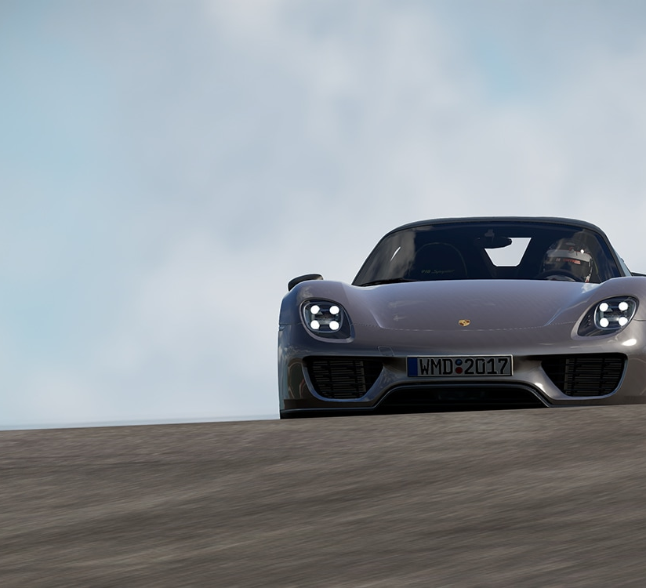
Data Audit on
Cars.xlsx Dataset
Furkan Demirdoven

Slide 2
Brief description of the dataset
Collected to analyze car models and their characteristics
93 observations
26 variables

Slide 3
First 10 observations
Manufacturer | Model | Category | Min_Price | Mid_Price | Max_Price | City_Fuel | Hwy_Fuel | Air_Bags | Drive_Train | Cylinders | Engine_Size | Max_HP | Max_HP_RPM | RPM_high | Manual | Fuel_Tank | Passenger | Length | Wheel_Base | Width | U_Turn_Diam | Rear_Room | Luggage | Weight | Domestic
Acura | Integra | Small | 12.9 | 15.9 | 18.8 | 25 | 31 | 0 | 1 | 4 | 1.8 | 140 | 6300 | 2890 | 1 | 13.2 | 5 | 177 | 102 | 68 | 37 | 26.5 | 11 | 2705 | 0
Acura | Legend | Midsize | 29.2 | 33.9 | 38.7 | 18 | 25 | 2 | 1 | 6 | 3.2 | 200 | 5500 | 2335 | 1 | 18 | 5 | 195 | 115 | 71 | 38 | 30 | 15 | 3560 | 0
Audi | 90 | Compact | 25.9 | 29.1 | 32.3 | 20 | 26 | 1 | 1 | 6 | 2.8 | 172 | 5500 | 2280 | 1 | 16.9 | 5 | 180 | 102 | 67 | 37 | 28 | 14 | 3375 | 0
Audi | 100 | Midsize | 30.8 | 37.7 | 44.6 | 19 | 26 | 2 | 1 | 6 | 2.8 | 172 | 5500 | 2535 | 1 | 21.1 | 6 | 193 | 106 | 70 | 37 | 31 | 17 | 3405 | 0
BMW | 535i | Midsize | 23.7 | 30 | 36.2 | 22 | 30 | 1 | 0 | 4 | 3.5 | 208 | 5700 | 2545 | 1 | 21.1 | 4 | 186 | 109 | 69 | 39 | 27 | 13 | 3640 | 0
Buick | Century | Midsize | 14.2 | 15.7 | 17.3 | 22 | 31 | 1 | 1 | 4 | 2.2 | 110 | 5200 | 2565 | 0 | 16.4 | 6 | 189 | 105 | 69 | 41 | 28 | 16 | 2880 | 1
Buick | LeSabre | Large | 19.9 | 20.8 | 21.7 | 19 | 28 | 1 | 1 | 6 | 3.8 | 170 | 4800 | 1570 | 0 | 18 | 6 | 200 | 111 | 74 | 42 | 30.5 | 17 | 3470 | 1
Buick | Roadmaster | Large | 22.6 | 23.7 | 24.9 | 16 | 25 | 1 | 0 | 6 | 5.7 | 180 | 4000 | 1320 | 0 | 23 | 6 | 216 | 116 | 78 | 45 | 30.5 | 21 | 4105 | 1
Buick | Riviera | Midsize | 26.3 | 26.3 | 26.3 | 19 | 27 | 1 | 1 | 6 | 3.8 | 170 | 4800 | 1690 | 0 | 18.8 | 5 | 198 | 108 | 73 | 41 | 26.5 | 14 | 3495 | 1
Cadillac | DeVille | Large | 33 | 34.7 | 36.3 | 16 | 25 | 1 | 1 | 8 | 4.9 | 200 | 4100 | 1510 | 0 | 18 | 6 | 206 | 114 | 73 | 43 | 35 | 18 | 3620 | 1

Slide 4
Metadata
Variables | Type | Scale | Description
Manufacturer | Character | Nominal | Company that produces that car. 30 Levels
Model | Character | Nominal | Model. 93 Levels
Category | Character | Ordinal | Category in terms of size. 6 Levels
Min_Price | Numeric | Continuous | Minimum Price
Mid_Price | Numeric | Continuous | Midrange Price
Max_Price | Numeric | Continuous | Maximum Price
City_Fuel | Numeric | Discrete | City Fuel Consumption
Hwy_Fuel | Numeric | Discrete | Highway Fuel Consumption
Air_Bags | Numeric | Integer | Air Bags Standard [1,2,3]
Drive_Train | Numeric | Integer | Drive Train [0,1,2]
Cylinders | Numeric | Discrete | Number of Cylinders
Engine_Size | Numeric | Continuous | Engine Size
Max_HP | Numeric | Discrete | Maximum Hourse Power
Max_HP_RPM | Numeric | Discrete | Maximum RPM
RPM_high | Numeric | Discrete | RPM High
Manual | Numeric | Binary | Manual Transmission [0,1]
Fuel_Tank | Numeric | Continuous | Fuel Tank Capacity
Passenger | Numeric | Discrete | Passenger Capacity
Length | Numeric | Discrete | Length
Wheel_Base | Numeric | Discrete | Wheel Base
Width | Numeric | Discrete | Width
U_Turn_Diam | Numeric | Discrete | U-turn diameter
Rear_Room | Numeric | Continuous | Rear Seat Room
Luggage | Numeric | Discrete | Luggage Capacity
Weight | Numeric | Discrete | Weight
Domestic | Numeric | Binary | Domestic [0,1]

Slide 5
Summary statistics

Slide 6
What does descriptive table tell? us
Missing values for theMissing values for the variables
  Luggage
  Rear_Room
  Cylinders variables
Outlier in Mid_Price variable: 151
Skewness, kurtosis not a problem for most variables except Mid_Price

Slide 7
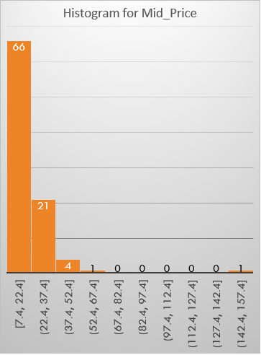
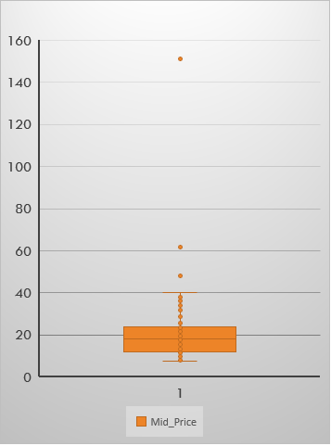
Closer look on mid_price variable

Slide 8
Frequency tables for categorical variables
Manufacturer
Model
Category
Air Bags
Drive_Train
Domestic
Manual

Slide 9
Frequency tables

Slide 10

Thanks

